Slide 1
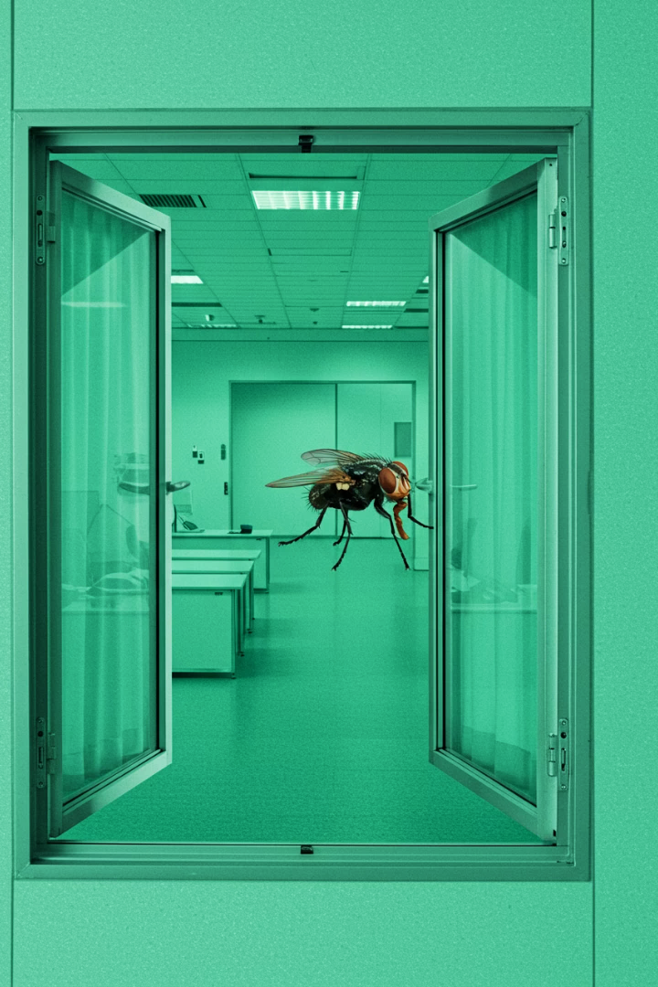

The cost of one mistaken click
A true story of deception, digital espionage, and a wake-up call to us all

Slide 2
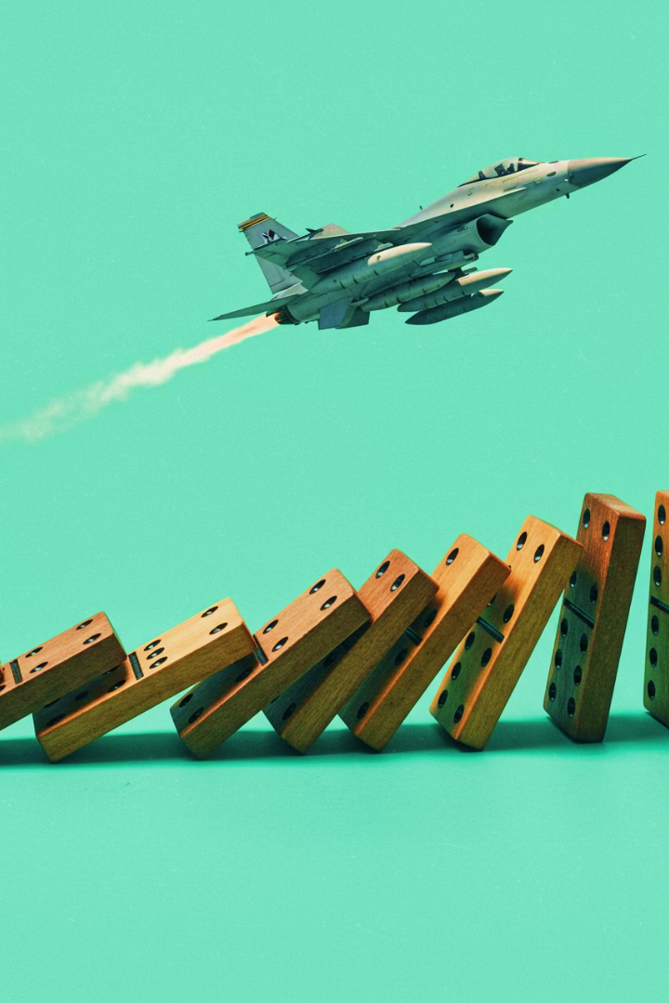
Looking back from the present
Today, China is preparing to field its 6th-generation fighter jet.
A potential game-changer in air superiority across Asia.
But part of this story didn't begin with design or engineering.
It began over a decade ago…
With one email. One click.

Slide 3
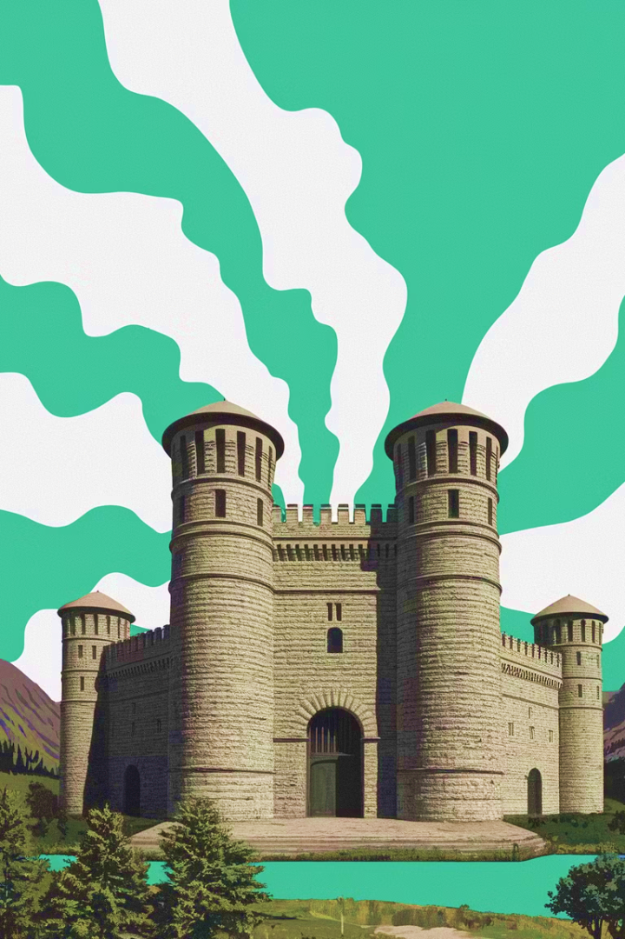
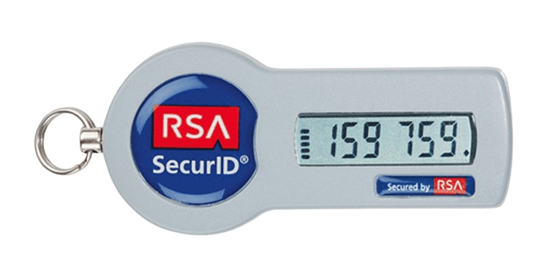

The calm before the storm
It was March 2011. RSA, a trusted guardian of digital identities, stood at the forefront of cybersecurity. Its crown jewel—SecureID—protected access to governments, militaries, and the world's biggest companies.
Billions of dollars, national secrets, and critical infrastructure—all shielded by one system. And then... the attackers came.

Slide 4
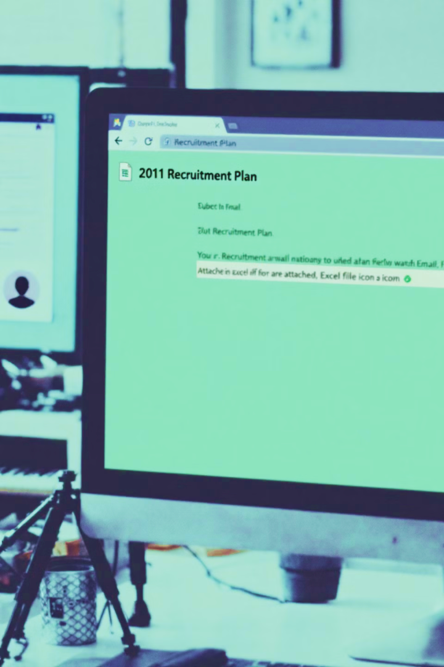
The phish that slipped through
One email. Subject line: "2011 Recruitment Plan." It looked innocent—just an Excel spreadsheet.
You wouldn't believe how simple it was—unformatted, not long, not unique. But hidden inside: malicious code that took advantage of an unknown Excel flaw. It bypassed defenses, dropped malware, and opened the gates.

Slide 5

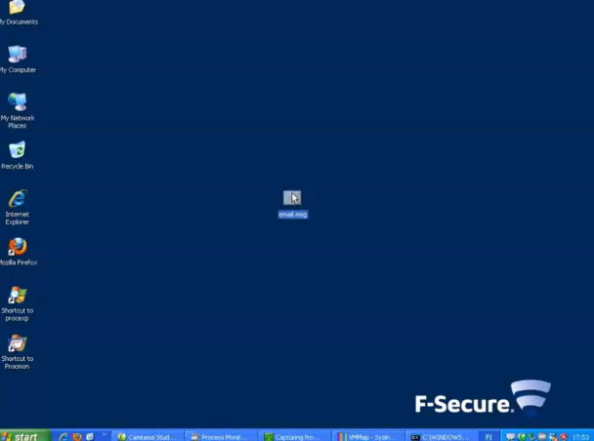
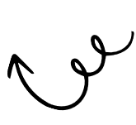
From the Employee’s Perspective
The file opened.
Excel flashed on the screen — then closed.
No strange behavior.
No alerts.
No visible signs of compromise.
For the employee who clicked, it looked like a glitch.
No reason to suspect anything.
Play the video to experience how normal it looked to the employee who clicked

Slide 6
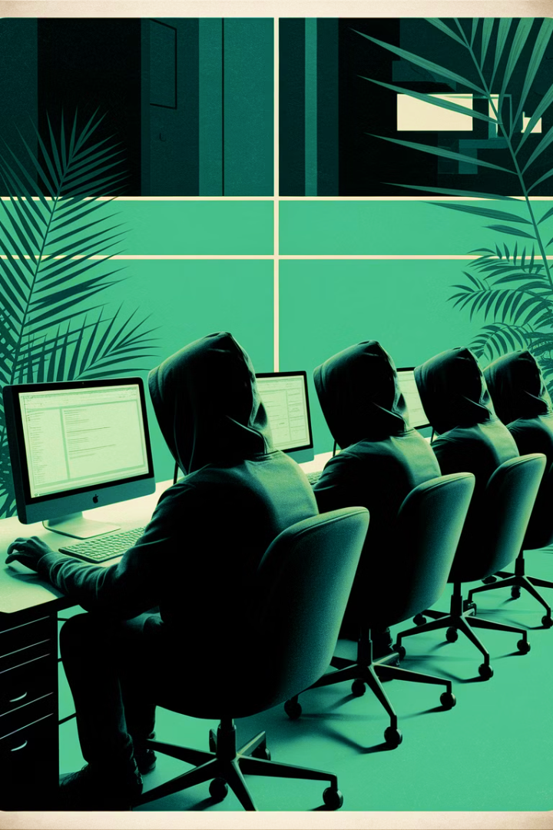
The silent invasion
The attackers moved quietly. They watched. They mapped. They exfiltrated sensitive data—undetected. Their target wasn't RSA's finances. It was the very blueprint of SecureID.
They weren't just stealing secrets. They were acquiring the code that grants access everywhere.

Slide 7
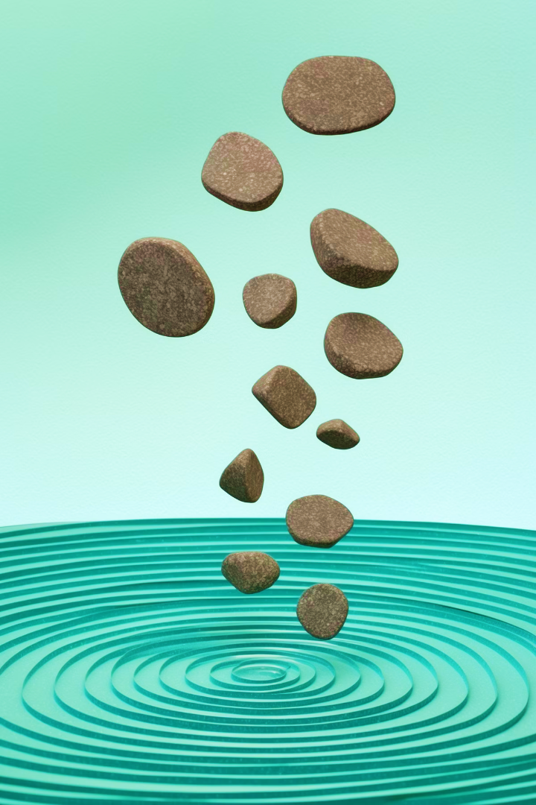
The ripple effect begins
RSA issued a vague statement: "We've been breached. SecureID may be compromised."
Panic spread across industries. Defense contractors scrambled. Corporations feared backdoors into their most protected systems. Even the US government was alarmed. Because if SecureID was broken, no one was safe.

Slide 8
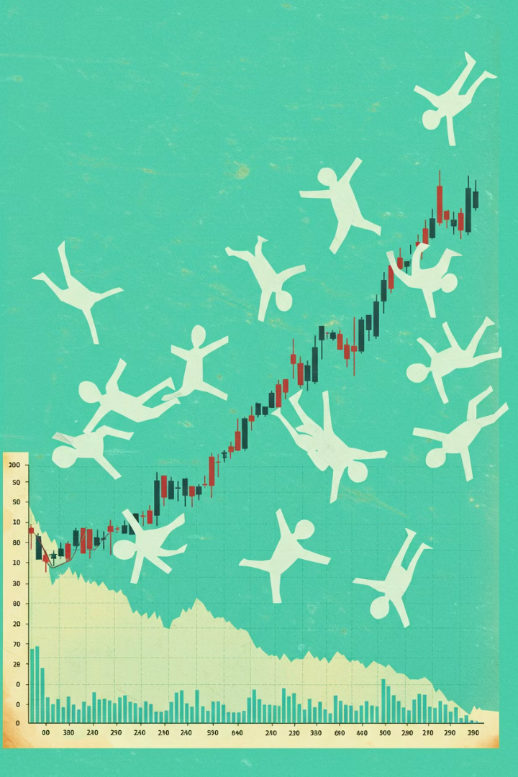
Business consequences for RSA
RSA paid a high price:
Millions of tokens replaced
Clients lost
Reputation damaged
Public trust shaken
The brand that once defined digital security became a cautionary tale.
RSA survived—but it never led again.

Slide 9
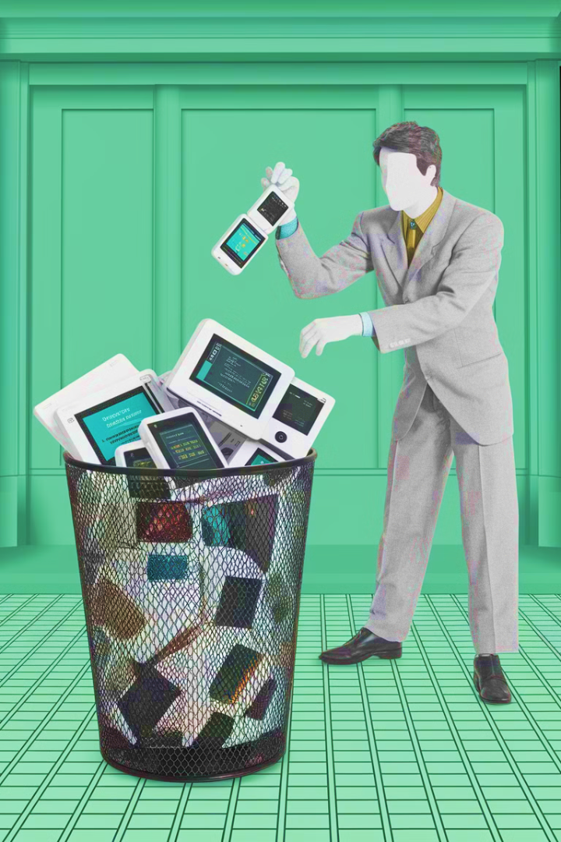
Real-world consequences
Not long after, Lockheed Martin, a top U.S. defense contractor and one of RSA's major clients, was attacked. The attackers used cloned SecureID tokens.
RSA's breach wasn't just a company problem—it was a national security crisis. Organizations were forced to replace millions of tokens, increasing monitoring, and rethinking access strategies. For many, it was a major operational and financial challenge.

Slide 10
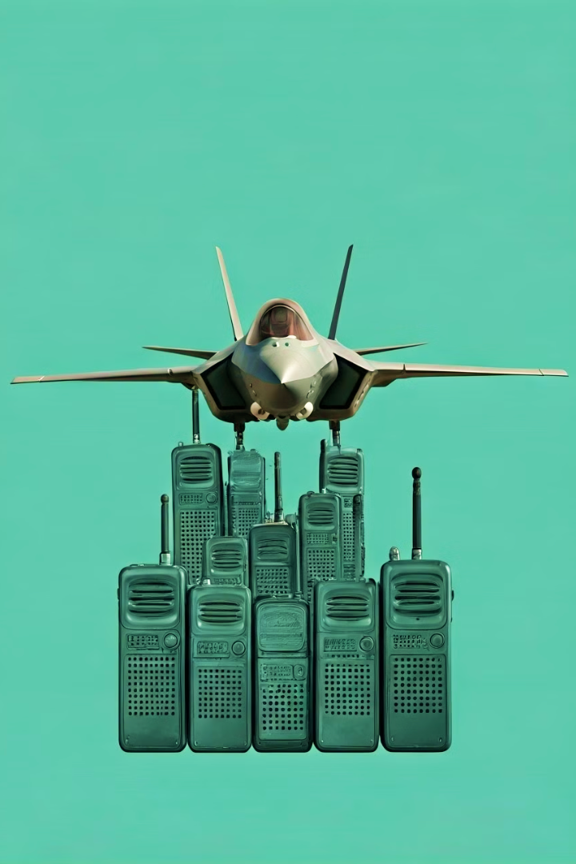
From one breach to global impact
After RSA’s breach, attackers targeted other defense contractors. L3 Communications, a key F-35 partner, was hit.
Shortly after, China unveiled the J-20 stealth fighter, showing striking similarities to the F-35.
What started as a phishing email may have sped up China’s military tech by years.

Slide 11
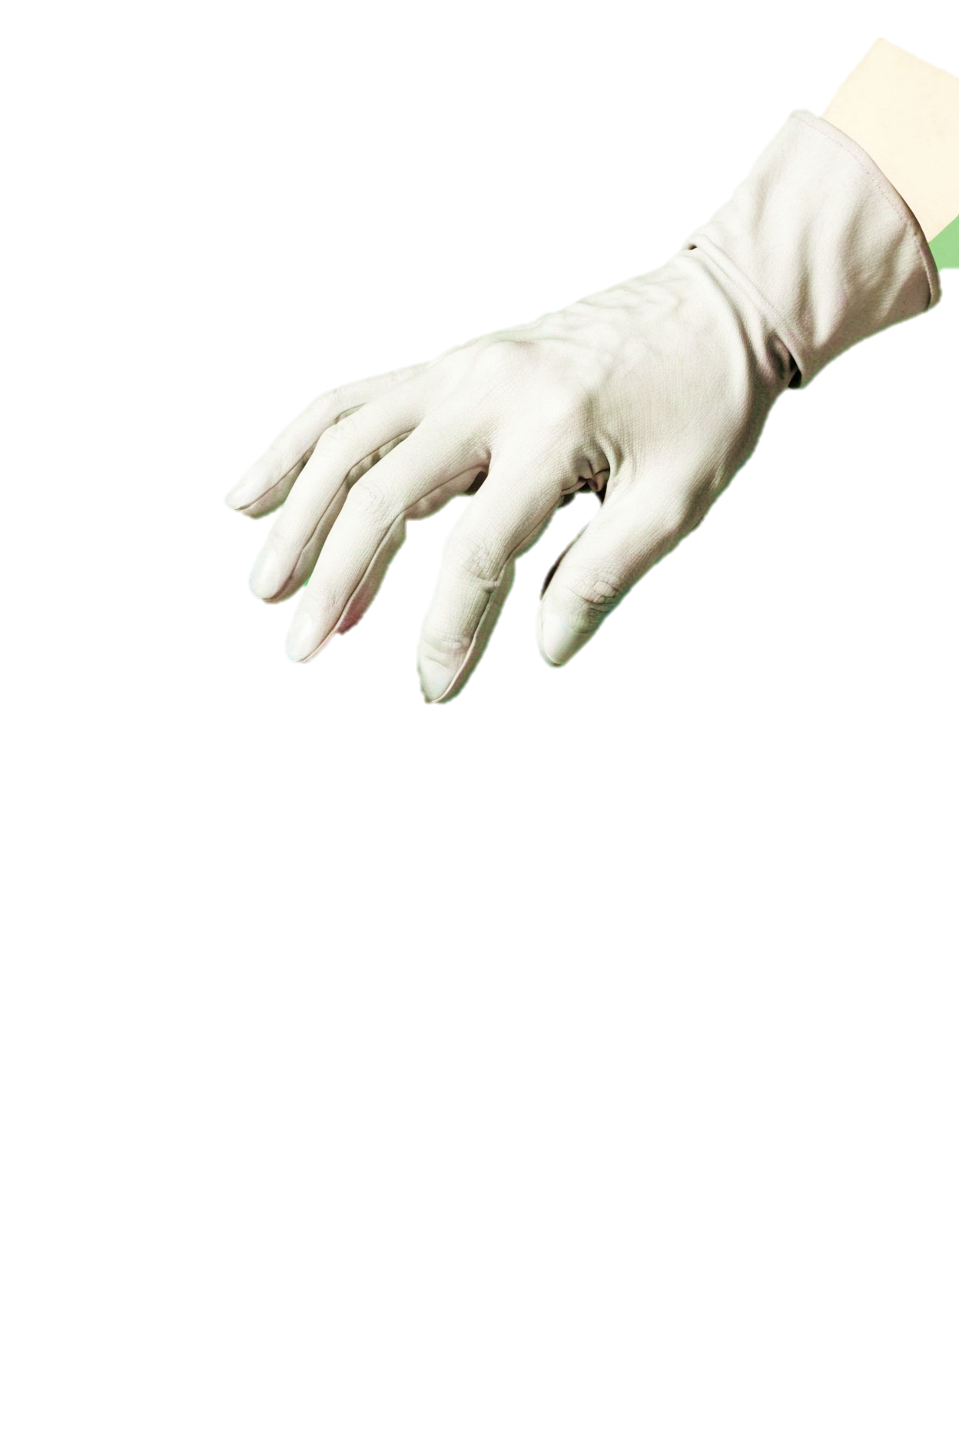
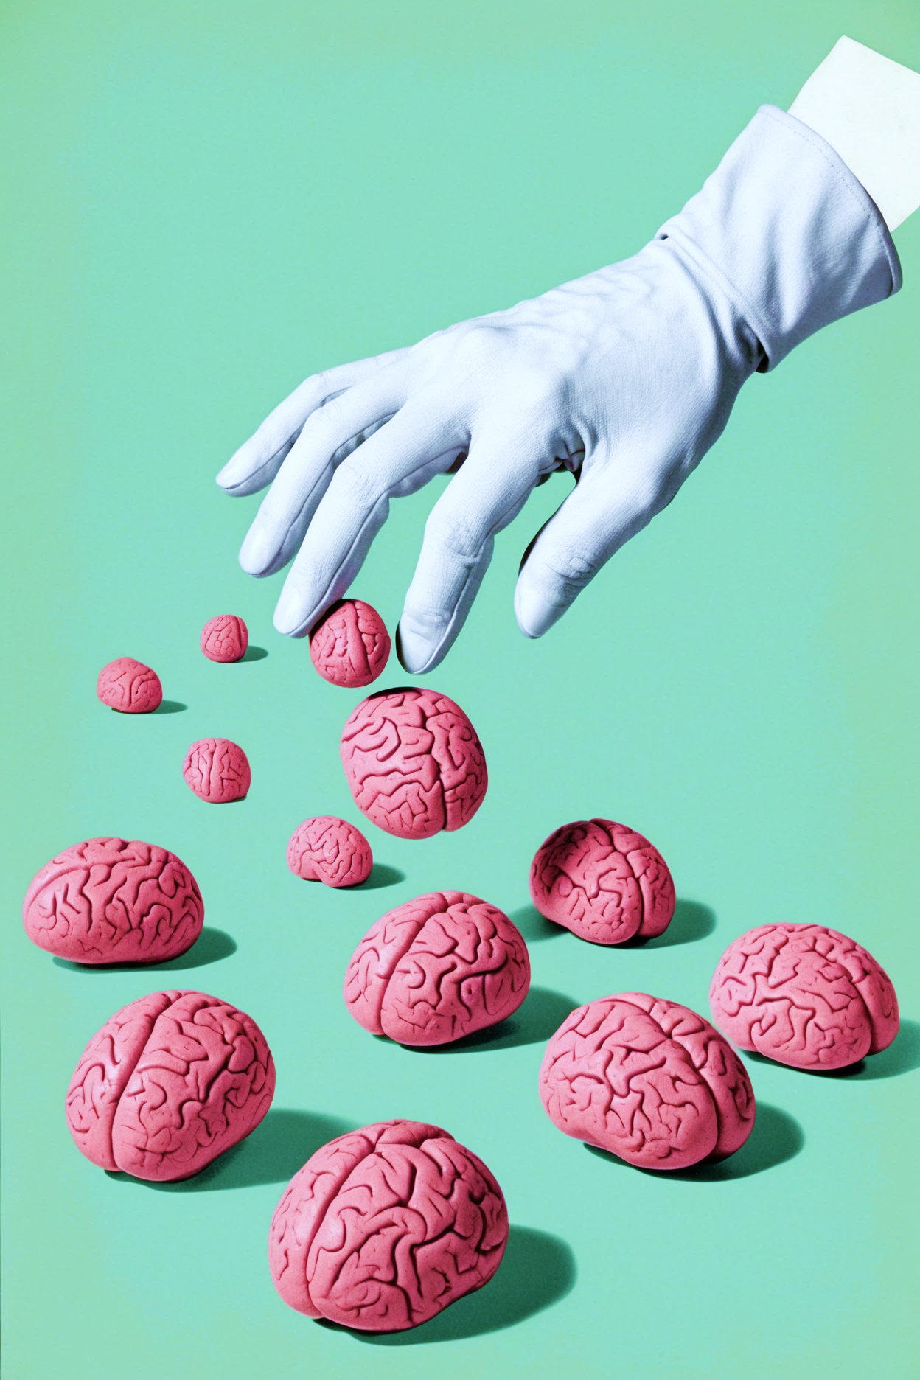
what can we learn from this story?
Cybersecurity isn't just a technical problem—it's an organizational one.
Every employee is a potential entry point.
Phishing is not a minor threat—it's a major attack vector.
No technology offers 100% protection against human error.
Even advanced systems can be undone by a single click.

Slide 12
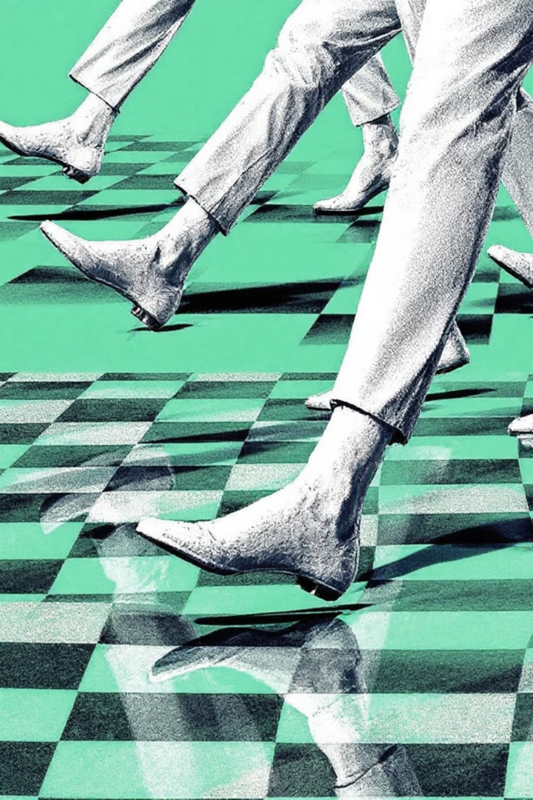
Now it's our move
The RSA breach was A wake-up call A single email. A single click. A chain reaction across the global security landscape.
What we do today—how we train, how we respond, how we think—matters.

